Slide 1
Research projects
Anne

Slide 2
1. The gap between artificial intelligence products and research in mental healthcare

Slide 3
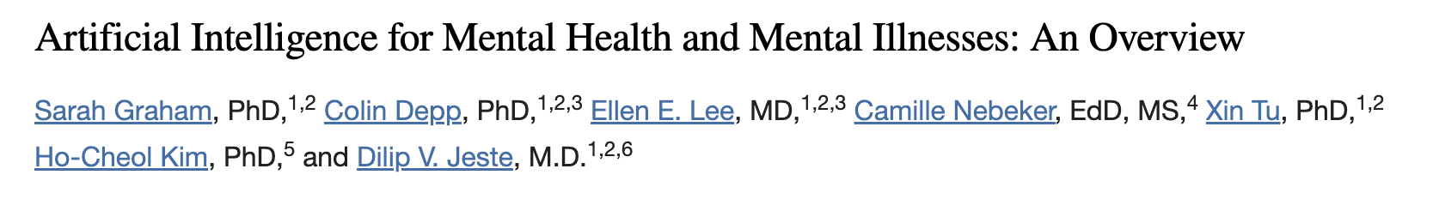
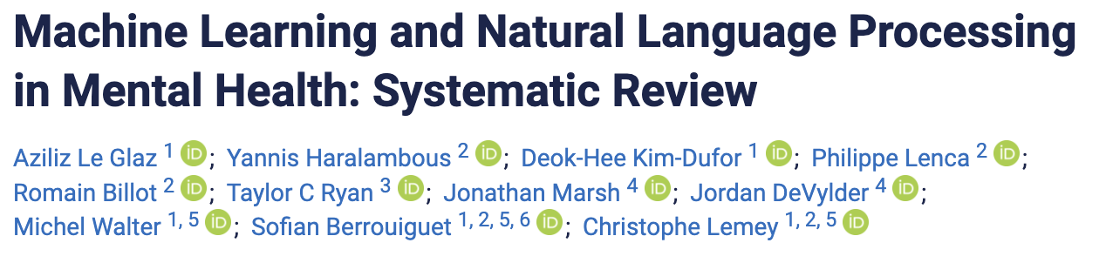
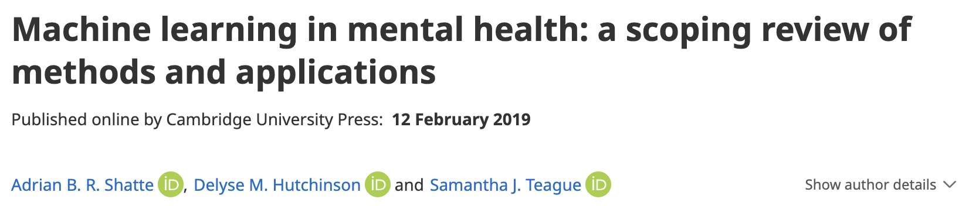
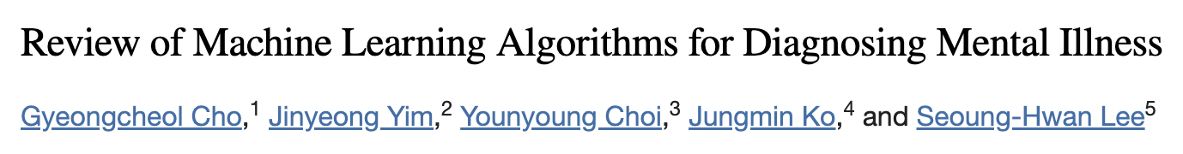
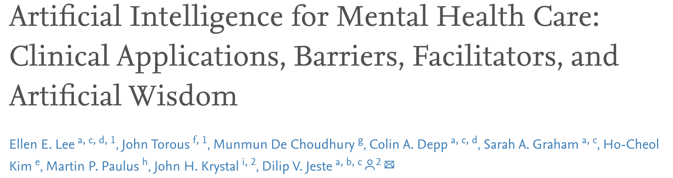
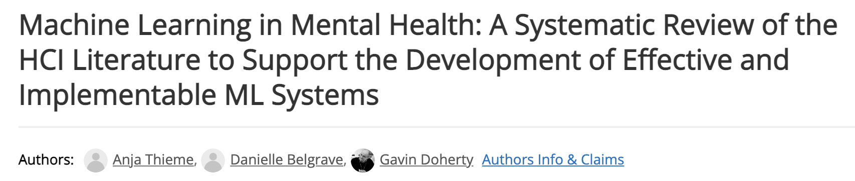
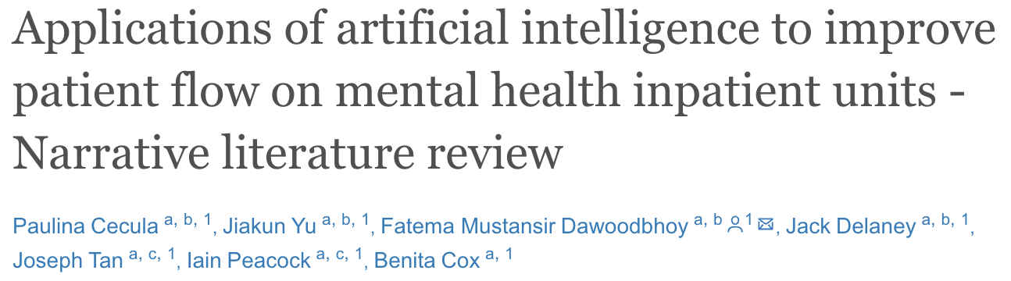
The background
Hundreds of research findings on AI technology for detection, diagnosis, treatment (selection), and improvement of mental healthcare

Slide 4
Research in AI technology for mental healthcare
Shatte et al. (2019) identified 190 mental health tools aiming to detect and diagnose mental health conditions, 67 focused on prognosis, treatment and support, 26 on public health applications, and 17 on research and clinical administration

Slide 5

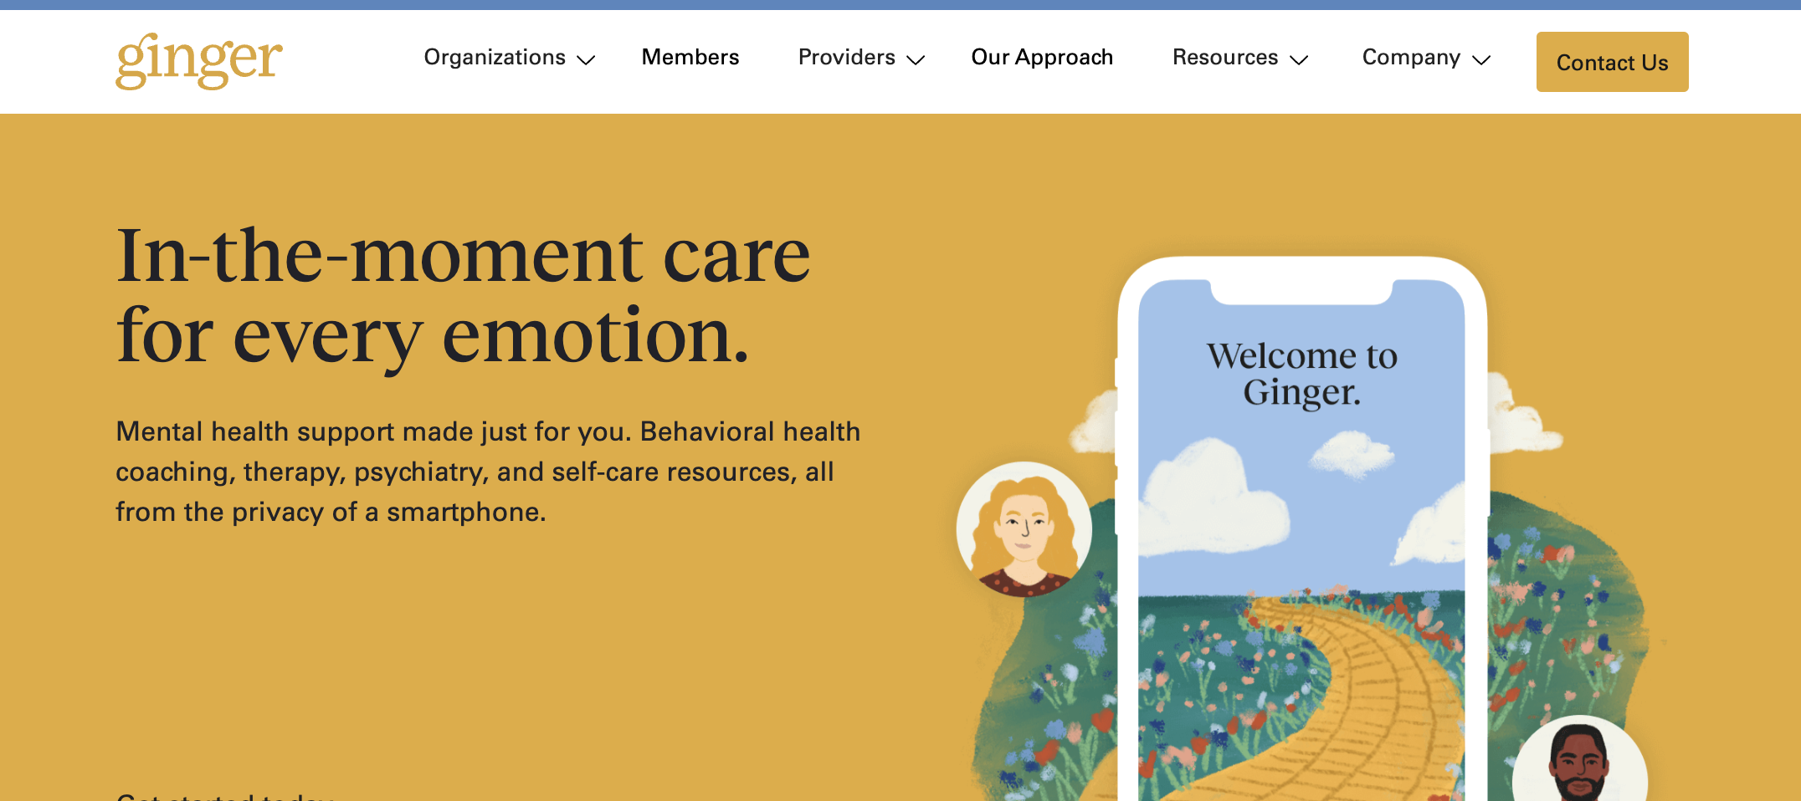
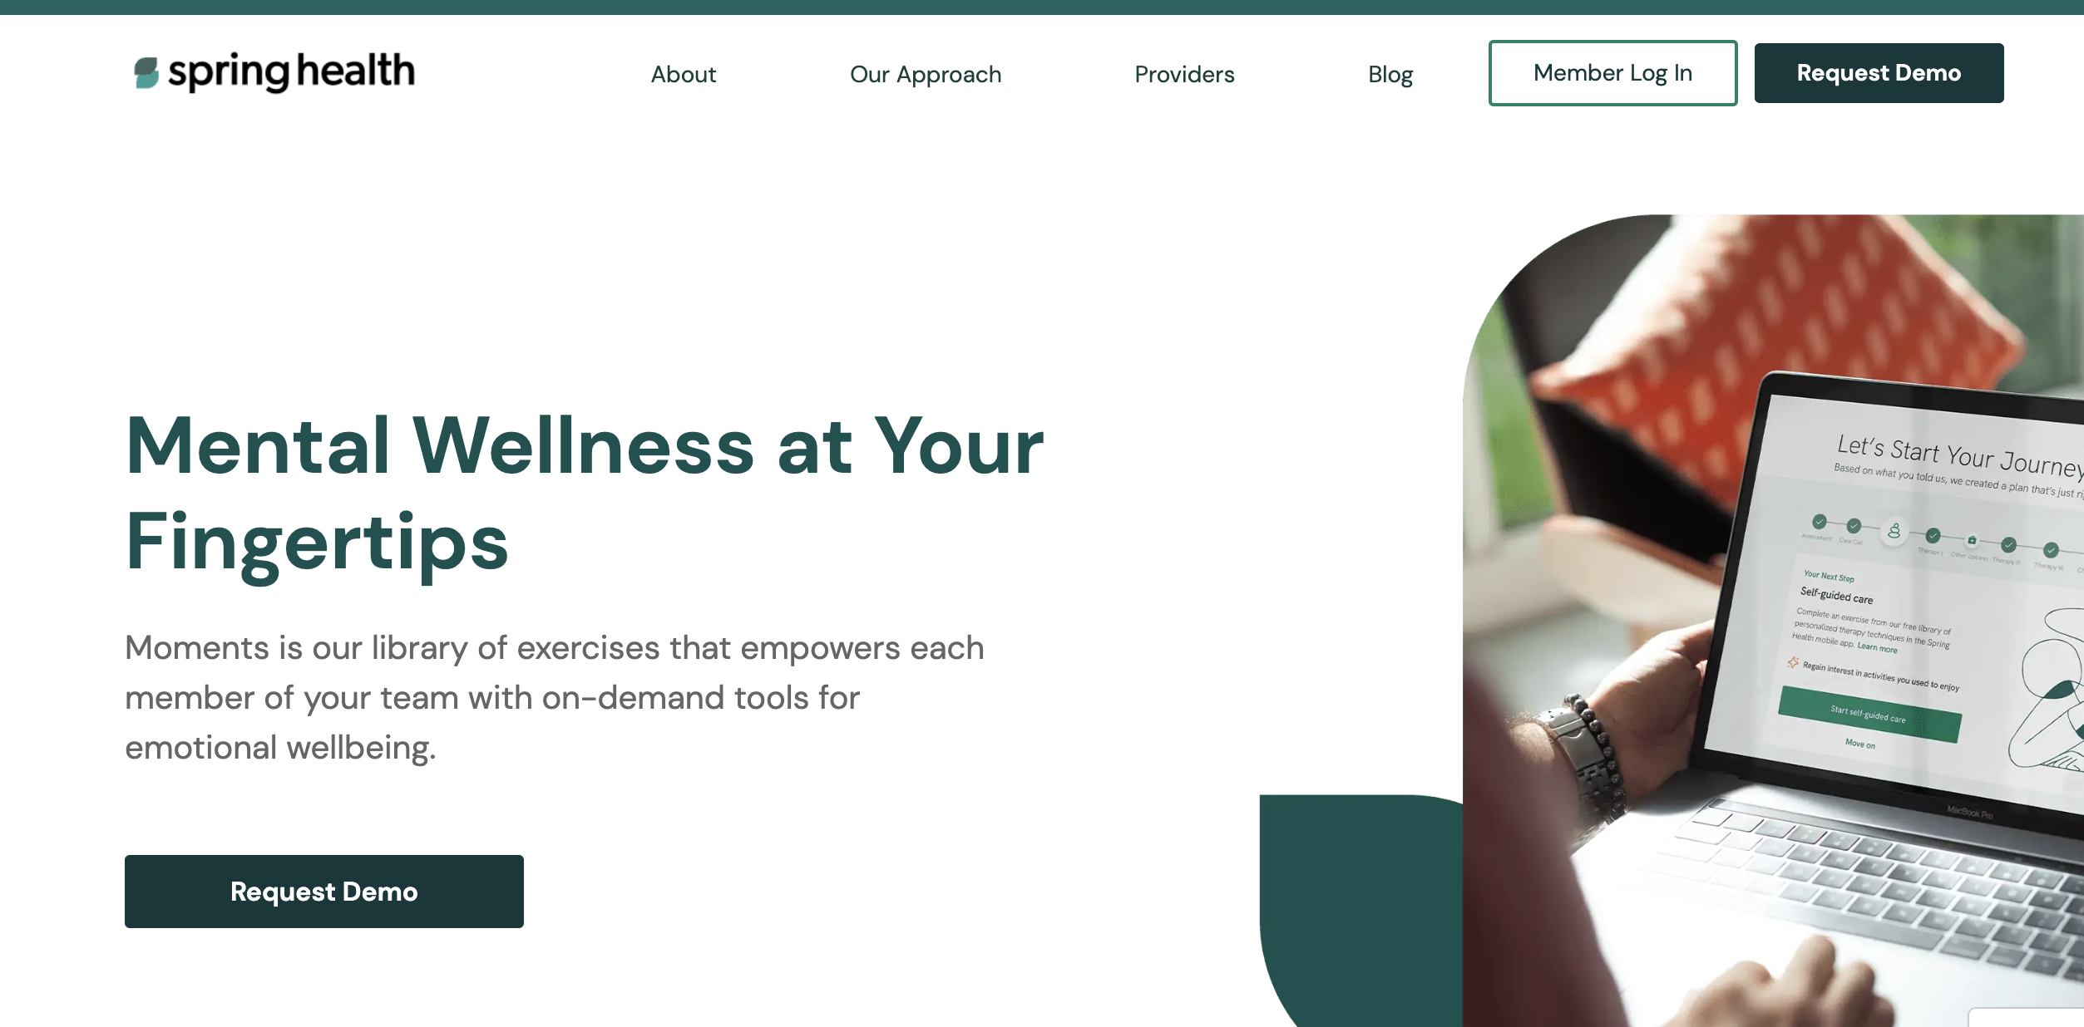
…at the same time
AI products available to mental health practitioners mainly focused on quality improvement of online CBT (barely diagnostics)

Slide 6
The idea
Review of research on AI mental health technolgy/ algorithms and available products
Identification and exploration of two aspects of research – practice gap:
Products without scientific evidence
Scientific evidence not used in practice
Research Questions:
What is the focus of research on AI technology in mental healthcare (diagnosis, treatment, treatment selection, or care quality improvement)?
What is the focus of AI products in mental healthcare (diagnosis, treatment, treatment selection, or care quality improvement)?
How many products are backed up by scientific evidence?
What are the main reasons why researched technology/ algorithms are not used in practice?

Slide 7
Approach
1) Systematic literature search of mental health technology/algorithms (PubMed)
Inclusion/ exclusion criteria:
Machine learning system for:
Detection/diagnosis
Treatment/ treatment selection
Practitioner training/ treatment quality improvement
In the mental healthcare area (Shatte et al. 2019):
Used by primary mental healthcare providers (i.e., no chatbots, …)
Detection/diagnosis and treatment/ treatment selection regarding DSM-5 diagnosis (excluding neurocognitive disorders like dementia)
Not merely development paper (i.e., needs to include test dataset)
Only published articles
Published in English or German
2) Information collection mental health products
3) Collect information from scientists and product developers
4) Research-practice gap analysis

Slide 8
1) Information collection from scientific articles
Study information:
Paper info (e.g., Publication year)
Study setting (e.g., country, institute)
Sample information (e.g., sample size, age, gender distribution)
Goal of the algorithm
Category (diagnosis, treatment)
Raw data modality (e.g., written text)
Best algorithm
Selected predictors
Performance (e.g., accuray, specificity)
Author contact information
(If available): Product information

Slide 9
2) Information collection from products
Multiple sources (Google, twitter, newspaper reports…)
Product information:
Product name
Company
Contact
Disease targeted
Key features (what does the product do?)
Suggested use (product aim)
Intended population
Type of input data
Type of output (e.g., app)
Integration (e.g., clinical information system)
Deployment (e.g., cloud-based)
Analysis trigger (what does the clinician have to do to see results?)
Processing time (how long does it take to see results after request)
Certification (CE and FDA)
On market since
Countries present
Pricing model
Pricing basis

Slide 10
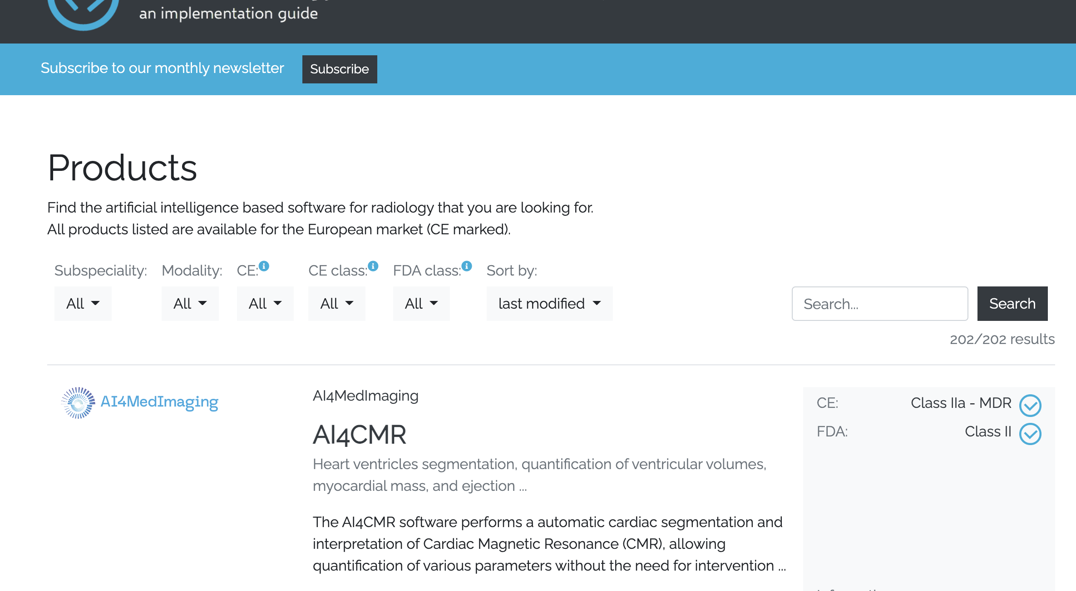
3) Contacting researchers and product developers
Goal: collect product information using online questionnaire
Simultaneously: display product information on website (similar to https://grand-challenge.org/aiforradiology/)

Slide 11
4) Research practice gap analysis
Overview of research and product information
Analysis of clinical application disparity between research and identified products
Systematic processing and presentation of researcher and product developer information (gathered during contact phase)

Slide 12
2. Medical and psychology students’ attitude towards AI technology in mental healthcare

Slide 13
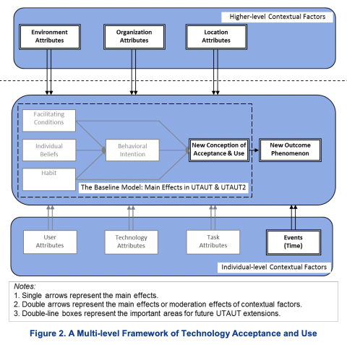


Slide 14
Stable higher-level contextual factors:
Environment
Location
Facilitating conditions
Individual beliefs
performance expectancy*
effort expectancy*
social influence
hedonic motivation*
price value
Acceptance/ attitude
SEE NEXT SLIDE
Intention to use
Intention to learn
Habit
User attributes
Demographics (age, gender)
Experience
Voluntariness
Occupation
user type (e.g., employees, consumers, and citizens)
Personality
GAAIS*
Technology attributes
Features of the target technology
Usability
Privacy
Trust in technology
Technology risks
Task attributes
diagnostics vs treatment vs training
Info:
Black: part of the original model
Grey: not relevant for study context
Green: additions
Red: needs to be manipulated
Notes:
Facilitating conditions:
Hong et al. (2009): defined as the degree to which individuals believe that an organizational and technical infrastructure exists to support use of the past upgrades of agile IS
Lancelot et al. (2015): whether an individual believes that some enabling factors exist to support acceptance of the system
Venkatesh et al. (2011): Facilitating conditions is defined as the degree to which an individual believes that organisational and technical infrastructure exist to support use of the IS (Venkatesh et al., 2003)
Performance expectancy:
Hong et al. (2011): Here, perceived usefulness (PU) is defined as the extent to which users believe using the past upgrades of agile IS enhances their job performance
Effort expectancy:
Hong et al. (2011): Here, perceived ease of use (PEOU) is defined as the extent to which users believe using the past upgrades of agile IS is free of effort
Hedonic motivation:
Venkatesh et al. (2012): Hedonic motivation is defined as the fun or pleasure derived from using a technology
GAAIS:
Schepman & Rodway (2021): The General Attitudes towards Artificial Intelligence Scale (GAAIS)
Positive and negative GAAIS

Slide 15
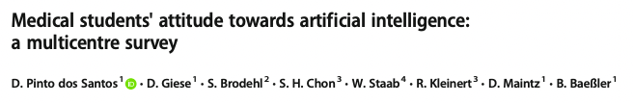
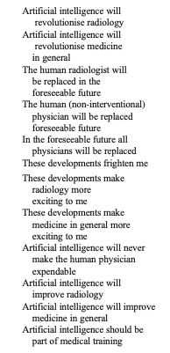
AI Attitudes Measurements (Medicine)
See also: https://www.birpublications.org/doi/pdf/10.1259/dmfr.20200461

Slide 16

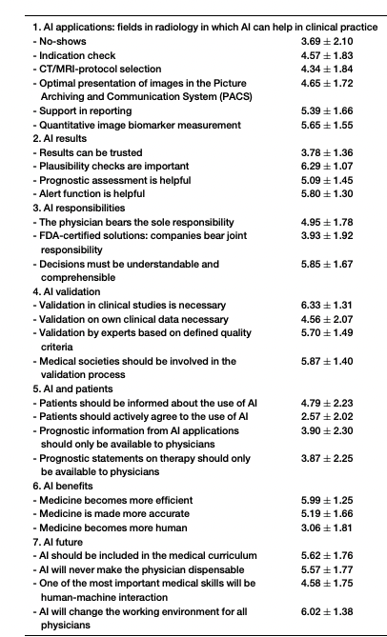
AI Attitudes Measurements (Medicine)

Slide 17
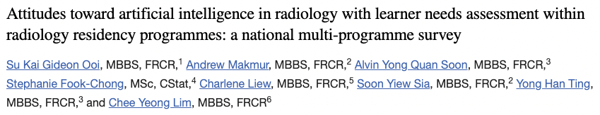
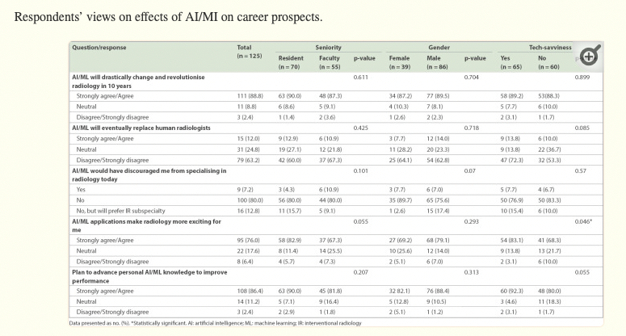
AI Attitudes Measurements (Medicine)

Slide 18
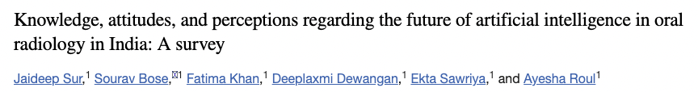
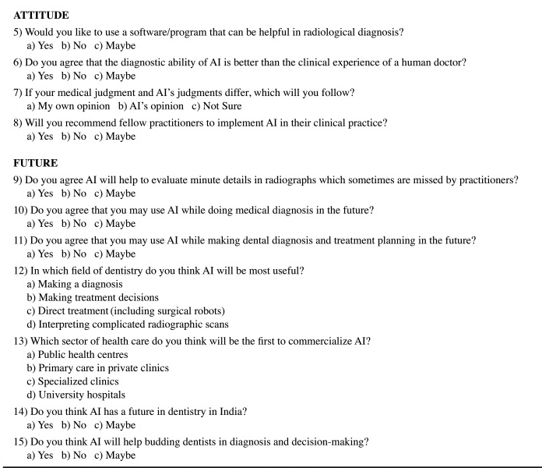
AI Attitudes Measurements (Medicine)

Slide 19
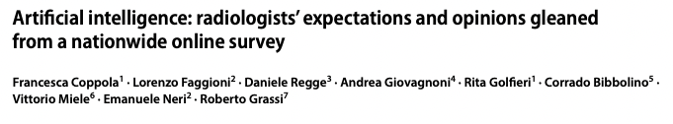
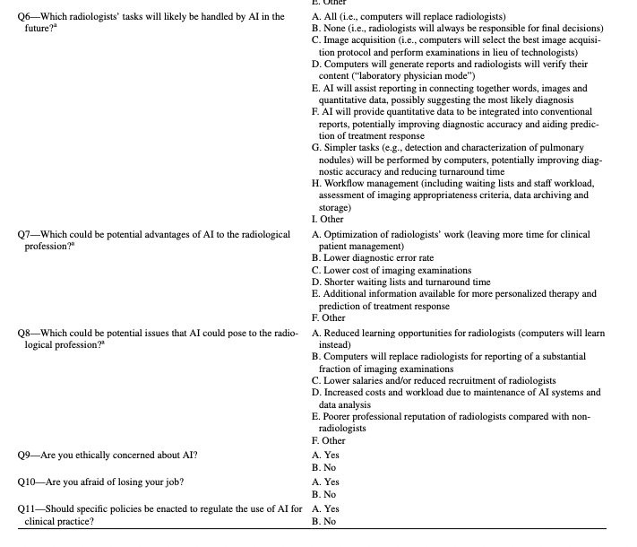
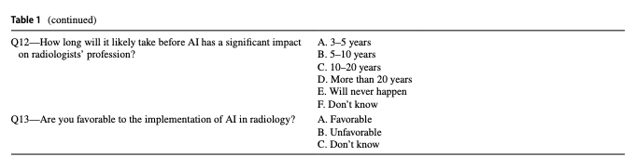
AI Attitudes Measurements (Medicine)

Slide 20
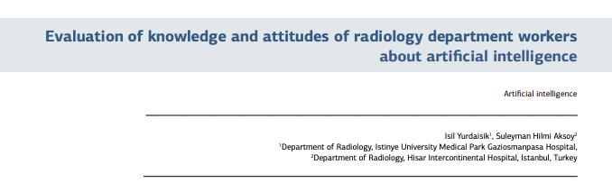
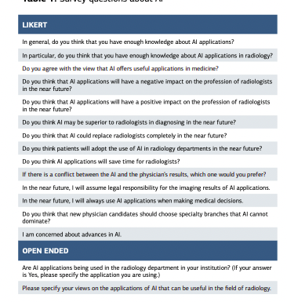
AI Attitudes Measurements (Medicine)

Slide 21
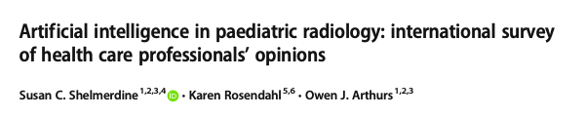
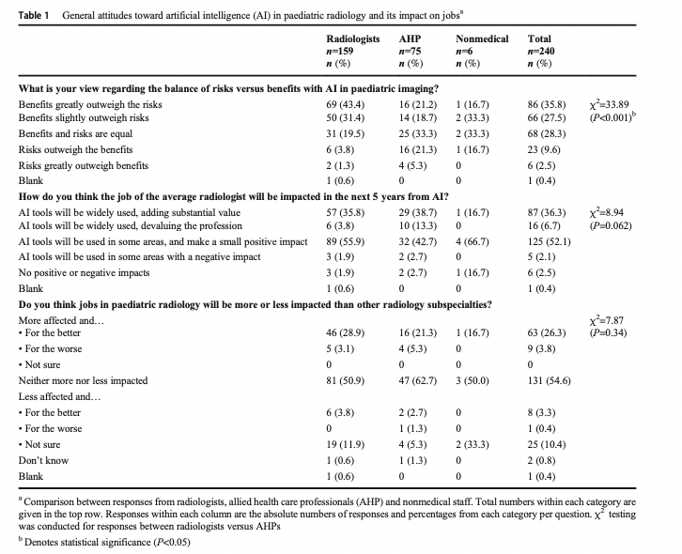
AI Attitudes Measurements (Medicine)

Slide 22
AI Attitudes Measurements (Medicine)
Possible categories (Jungmann et al., 2020):
Trust: “Recommendations of an AI system can be trusted”
Efficiency benefits: “Mental health care becomes more efficient”
Education: “AI should be included in the [psychology/ medical] curriculum”

